Slide 1
The Vision of DuBois Integrity Academy
To be a Blue Ribbon, High Performing, Charter District preparing students to compete globally

Slide 2
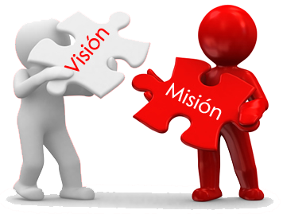
Our Mission
To prepare college and career ready scholars who are confident and inquisitive lifelong learners.

Slide 3
OUR MOTTO
Vision
Mission
Motto
Work Hard, Soar High, Make A Mark

Slide 4
To Develop, Empower & Inspire Leaders
To Replicate the vision
Throughout the state of Georgia and Southeast Region

Slide 5
Skills of a Great Leader

Slide 6
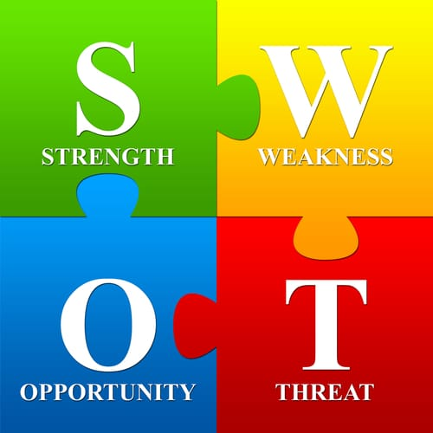
DIA SWOT Blue Ribbon School of Excellence Action Plan
A. Strengths
Dynamic Team
B. Weaknesses
Current Data
Critical Areas
Immediate Actions Report
Needs Improvement
C. Opportunities
Eligibility Schematic
DIA Exit Report
Action Plan
School Leaders present Corrective Action for K-5 and 6-8

Slide 7
DIA SWOT Blue Ribbon School of Excellence Action Plan
D. Threats
Lack of unity and cohesiveness
Difficult to recruit and retain high quality Teachers & Administrators (Backed by Data)
Test scores could negatively impact our ability to replicate in other areas
Could negatively affect Charter renewal

Slide 8
Effective Leaders are Able to Move from one Style of leadership to another depending on the situation

Slide 9
Leadership in Education plays an integral role in creating a positive school culture. It also influence student learning and achievement.

Slide 10
Great Leaders can Spin on the Wheel

Slide 11
Effective Leadership is the Epitome of Flexibility

Slide 12
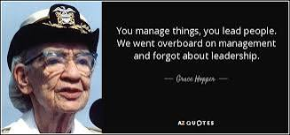

Slide 13
5 Effective Leadership Styles in Education
1. Instructional – Outperforms other schools
2. Transformational – Collaborative approach empowers their teams to have a say in the decisions collective goal setting
3. Constructive – Facilitating the learning process, rather than directing it
4. Servant – (No EGO) – Motivate and persuade their school, stakeholders and community to engage and fulfill the vision
5. Strategic – Not focused on day to day
Issues, future oriented, respond with the
most suitable approach and style

Slide 14
Resources
Exploring the different leadership styles,
Big Red Group, Nov. 14, 2022
Leadership Styles in Education, Dec. 14, 2021
Toast Masters International, 2022
Institute of Project Management, 2022
Indeed
Google

